Slide 1
SH Movies success
implies + TV Series ?
Metis SF Spring 2018 – Project Luther
Filippo Medri

Slide 2
IMPORTANT NOTE – do not edit this slide, builds content art elements before going to next content slide. Should go between title/section title slides and content slides.

Slide 3



Problem Statement
GOAL
“Does the success of Super Hero Movies affects the number of Super Hero TV Series of the next year? ”
Scraped data from 2501 Titles
Source: www.IMDB.com
From (“The Green Archer - 1920”)
To (“Defenders of the Gao – 2020”)
Created 2 Different Dataset:
Movies ← For feature extraction
TV Series ← For response variable

Slide 4

Features
Movies
Tv Series
IMDB Score
Number of IMDB users rating
Metascore from Metacritics
N. of reviews from users
N. of reviews from critics
Opening WE gross ( USA)
Gross (USA)
Gross (world wide)
Number of TV Series per year
Final Dataset
204 Entries
From 1978 to 2018

Slide 5
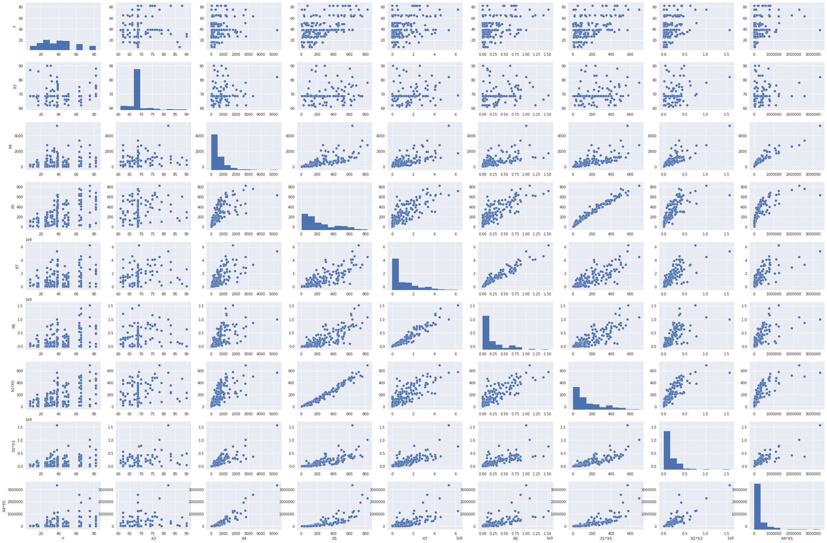
Best Model
Facts
Important Variables:
Metascore
N. Reviews (User)
N.Reviews (Critic)
Gross (USA)
Gross (WW)
Score combined with N.reviews - Crit
User rating combined with Metascore
N.reviews-users combined N.reviews Critic
Opening WE disappear !

Slide 6
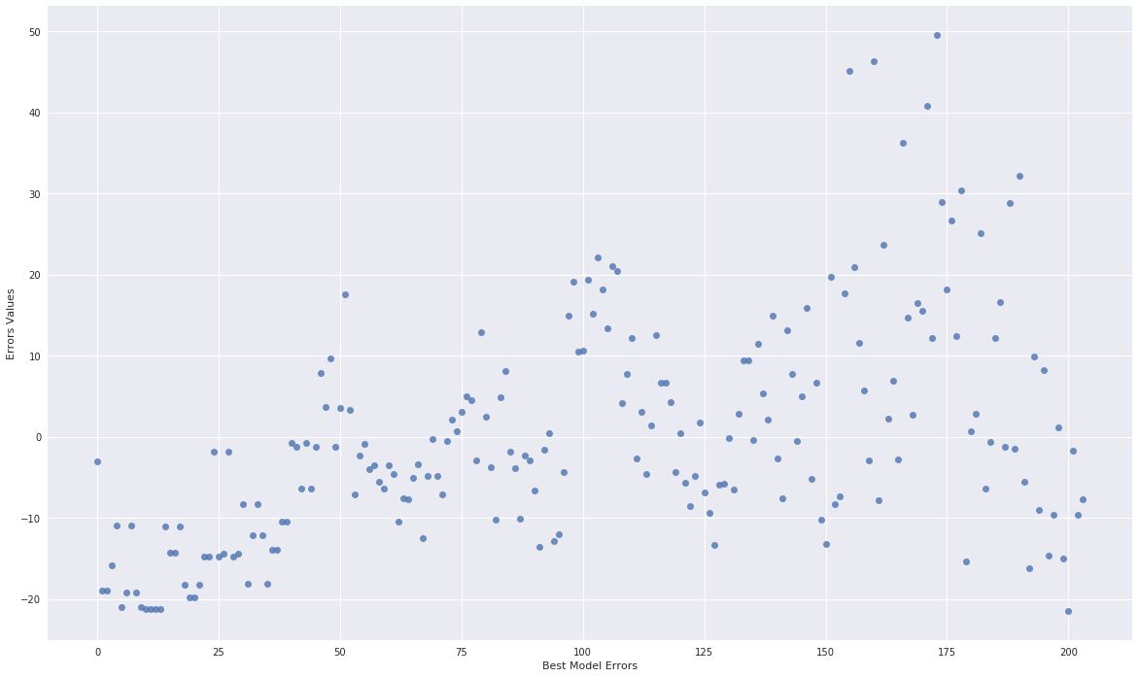
Best Model - Results
Preliminary
Adjusted R² ~ 0.4
Train/Test Split
Adjusted R² ~ 0.5
Graph shows Heteroscedasticity

Slide 7
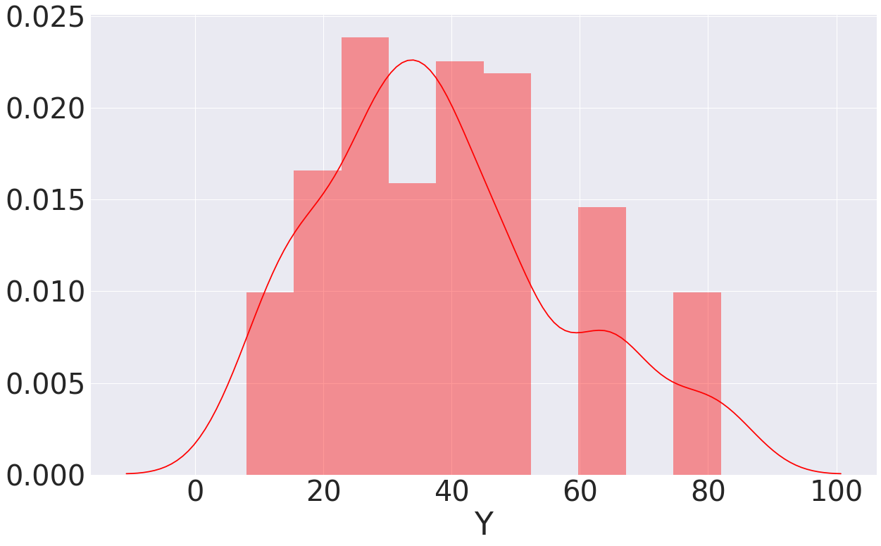
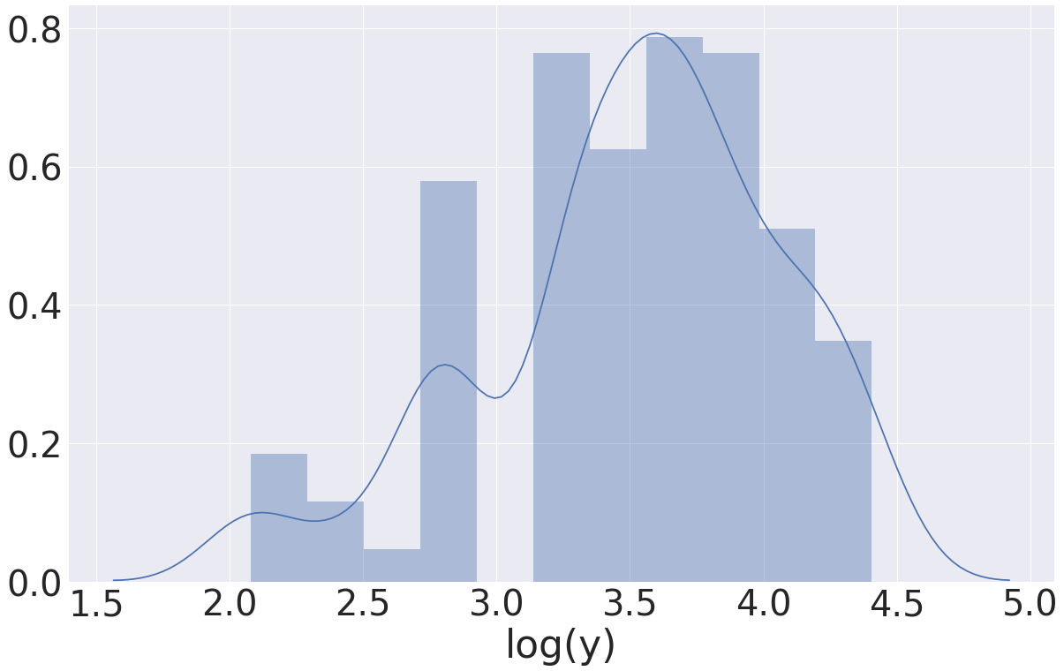
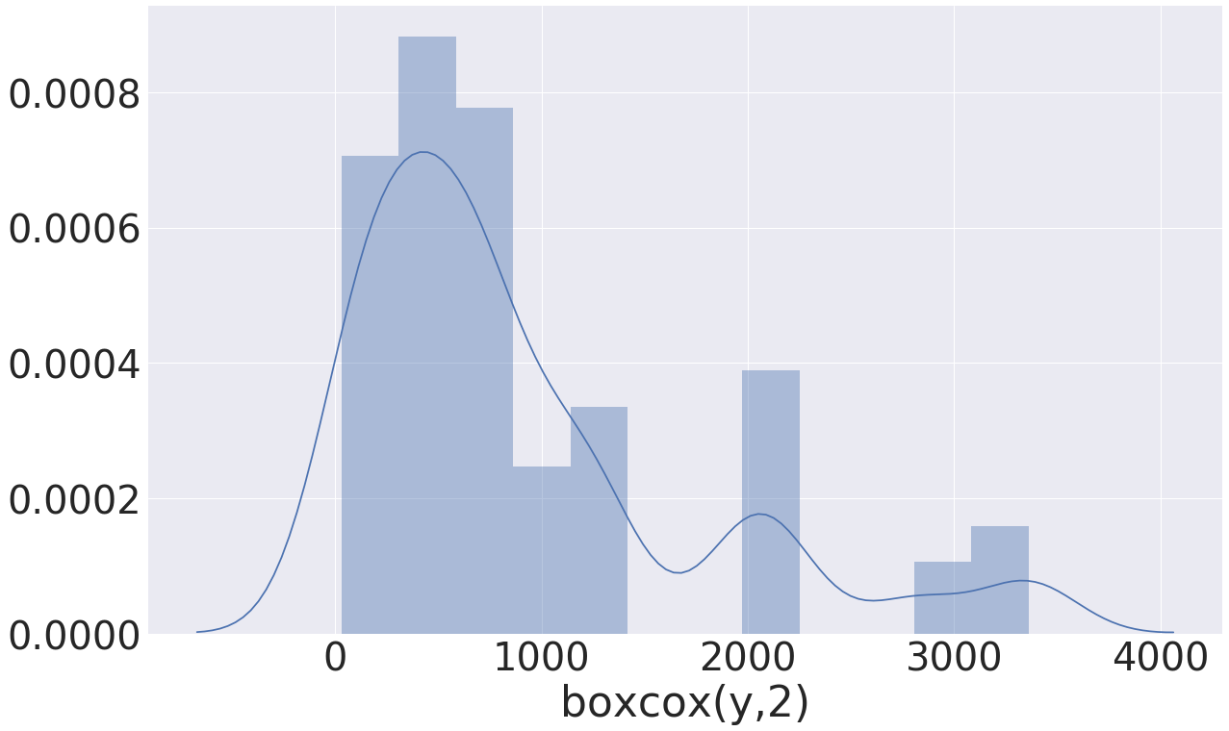
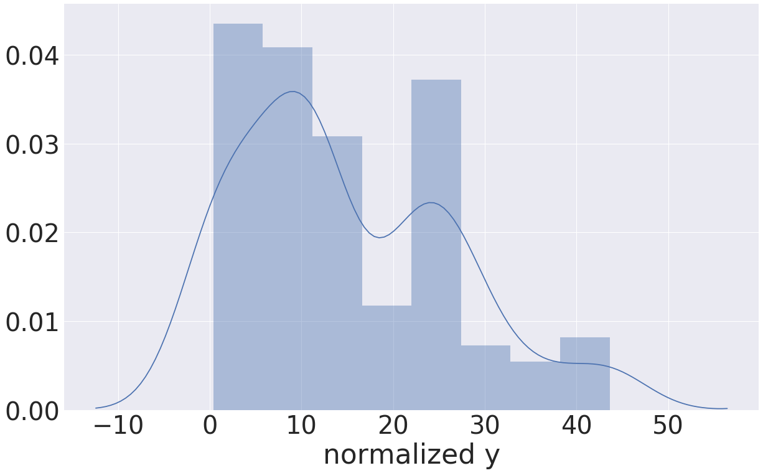
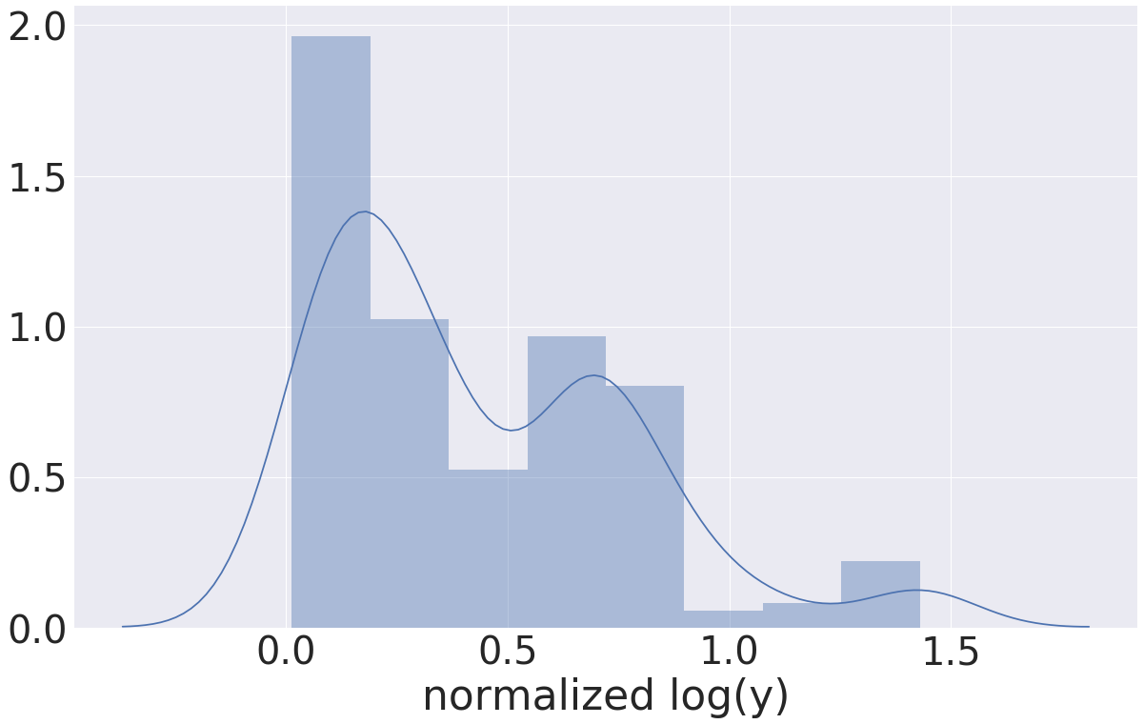
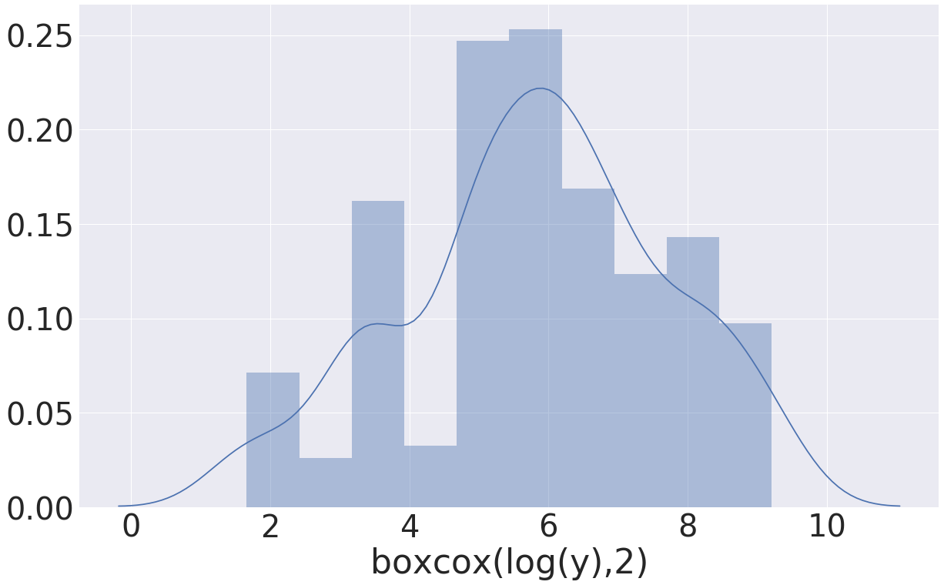
Can we improve by transform response?
Shapiro says NO!

Slide 8
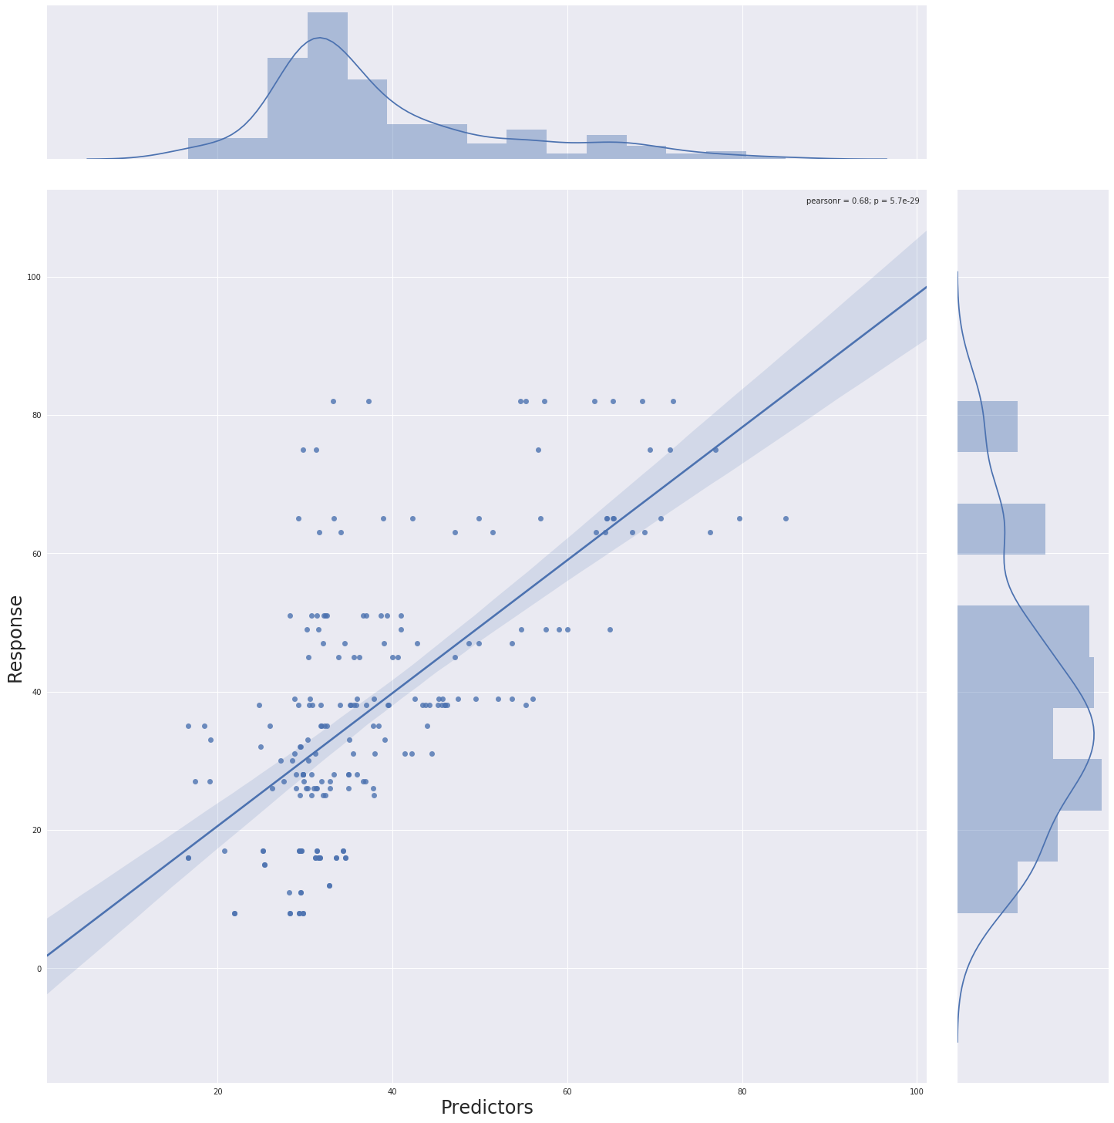
Model Regularization
Lasso regularization
Lambda 0.01
The model is promising
Set of features not captured

Slide 9
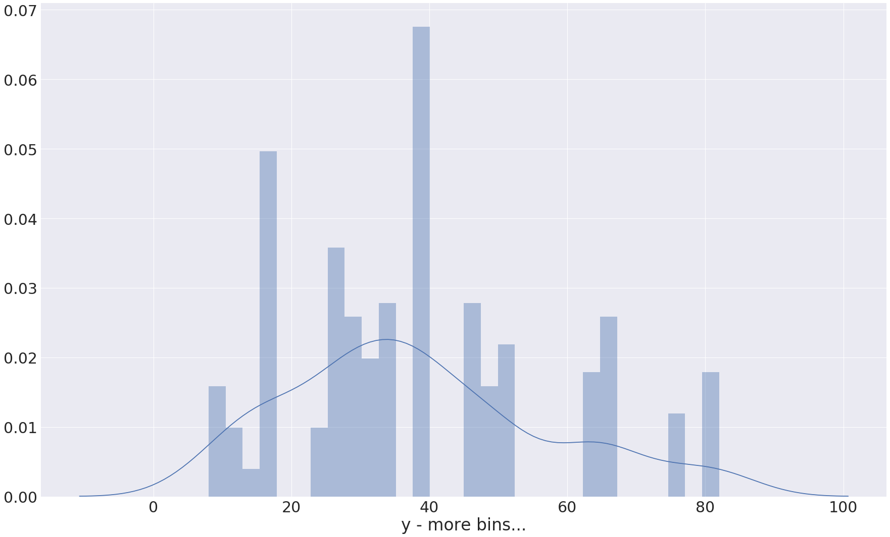
Next →
Y not even bimodal…
More features !
Maybe a model
not linear

Slide 11
 | coef | std err | t | P>|t| | [0.025 | 0.975]
Intercept | 56.5337 | 22.961 | 2.462 | 0.015 | 11.246 | 101.822
X1 | -5.0685 | 13.506 | -0.375 | 0.708 | -31.707 | 21.570
X5 | 0.1373 | 0.044 | 3.124 | 0.002 | 0.051 | 0.224
X1:X5 | -0.0981 | 0.069 | -1.413 | 0.159 | -0.235 | 0.039
X4 | -0.0139 | 0.005 | -2.759 | 0.006 | -0.024 | -0.004
X4:X5 | 1.098e-05 | 8.4e-06 | 1.308 | 0.193 | -5.58e-06 | 2.75e-05
X2 | -7.68e-05 | 5.46e-05 | -1.406 | 0.161 | -0.000 | 3.1e-05
X3 | -0.3746 | 0.319 | -1.173 | 0.242 | -1.005 | 0.255
X2:X3 | 1.243e-06 | 7.14e-07 | 1.742 | 0.083 | -1.65e-07 | 2.65e-06
X6 | -2.493e-08 | 8.84e-08 | -0.282 | 0.778 | -1.99e-07 | 1.49e-07
X7 | -1.455e-07 | 4.02e-08 | -3.620 | 0.000 | -2.25e-07 | -6.62e-08
X8 | 6.082e-08 | 1.49e-08 | 4.094 | 0.000 | 3.15e-08 | 9.01e-08

Slide 12
Dep. Variable: | Y | R-squared: | 0.472
Model: | OLS | Adj. R-squared: | 0.441
Method: | Least Squares | F-statistic: | 15.58
Date: | Thu, 26 Apr 2018 | Prob (F-statistic): | 1.62e-21
Time: | 11:07:39 | Log-Likelihood: | -823.99
No. Observations: | 204 | AIC: | 1672.
Df Residuals: | 192 | BIC: | 1712.
Df Model: | 11
Covariance Type: | nonrobust

